Slide 1
NextGen Tools Training
R – Data manipulation
February 2024

Slide 2
01
02
03
04
05
06
07
Reminders
Creating a project
Loading datasets
{tydiverse} family
Functions
Vectorization
Useful links and Q&A

Slide 3



Meet the authors
Anastasiia Andriushchenko
Linga Baddam
Nicholas Eugenio
Principal Stat. Programmer
Sr. Principal Stat. Programmer
Stat. Programmer I

Slide 4

eminders
Use official NextGen Tools™ channels!

Slide 5
NextGen Tools
Where to find help?
OCEAN;
OAK;
{admiral};
NEST;
GLoPO.

Slide 6
Creating a project
A reproducible project

Slide 7
Creating a project
Personal project and {renv} package
The objective of this presentation is to explain some data manipulation functions and tips;
Thanks for doing your homework and creating a new personal project named “data_manipulation”. Now you can put it aside, but don't forget the concepts you've learned!
As you are now familiar with the concepts of projects, libraries, repositories and .Rprofile, we are pleased to introduce the {renv} package ☺
{renv} package helps you create reproducible environments for your R projects, it makes them:​
Isolated: Installing a new or updated package for one project won’t break your other projects, and vice versa. That’s because {renv} gives each project its own private library;
Portable: Easily transport your projects from one computer to another, even across different platforms. {renv} makes it easy to install the packages your project depends on;
Reproducible: {renv} records the exact package versions you depend on, and ensures those exact versions are the ones that get installed wherever you go.

Slide 8
Creating a project
{renv} workflow
According to RStudio User Guide, the general workflow when working with {renv} is:
Call “renv::init()” to initialize a new project-local environment with a private R library;
Work in the project as normal, installing and removing new R packages as they are needed in the project;
Call “renv::snapshot()” to save the state of the project library to the lockfile (called renv.lock);
Continue working on your project, installing and updating R packages as needed;
Call “renv::snapshot()” again to save the state of your project library if your attempts to update R packages were successful, or call “renv::restore()” to revert to the previous state as encoded in the lockfile if your attempts to update packages introduced some new problems.

Slide 9
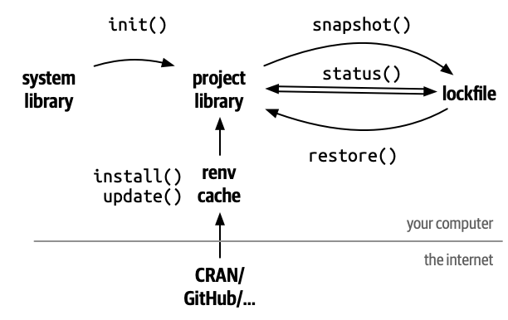
Setting a New Directory project
{renv} workflow
https://rstudio.github.io/renv/index.html, 02/08/2024

Slide 10
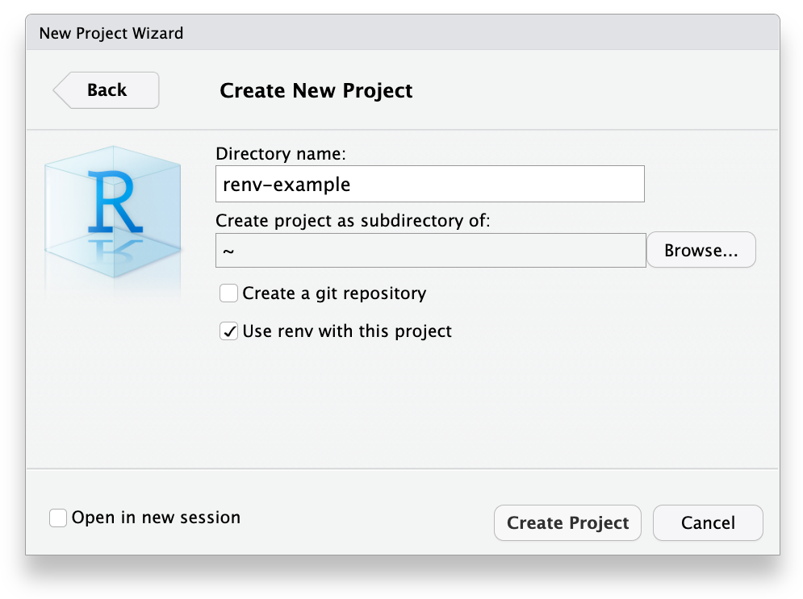
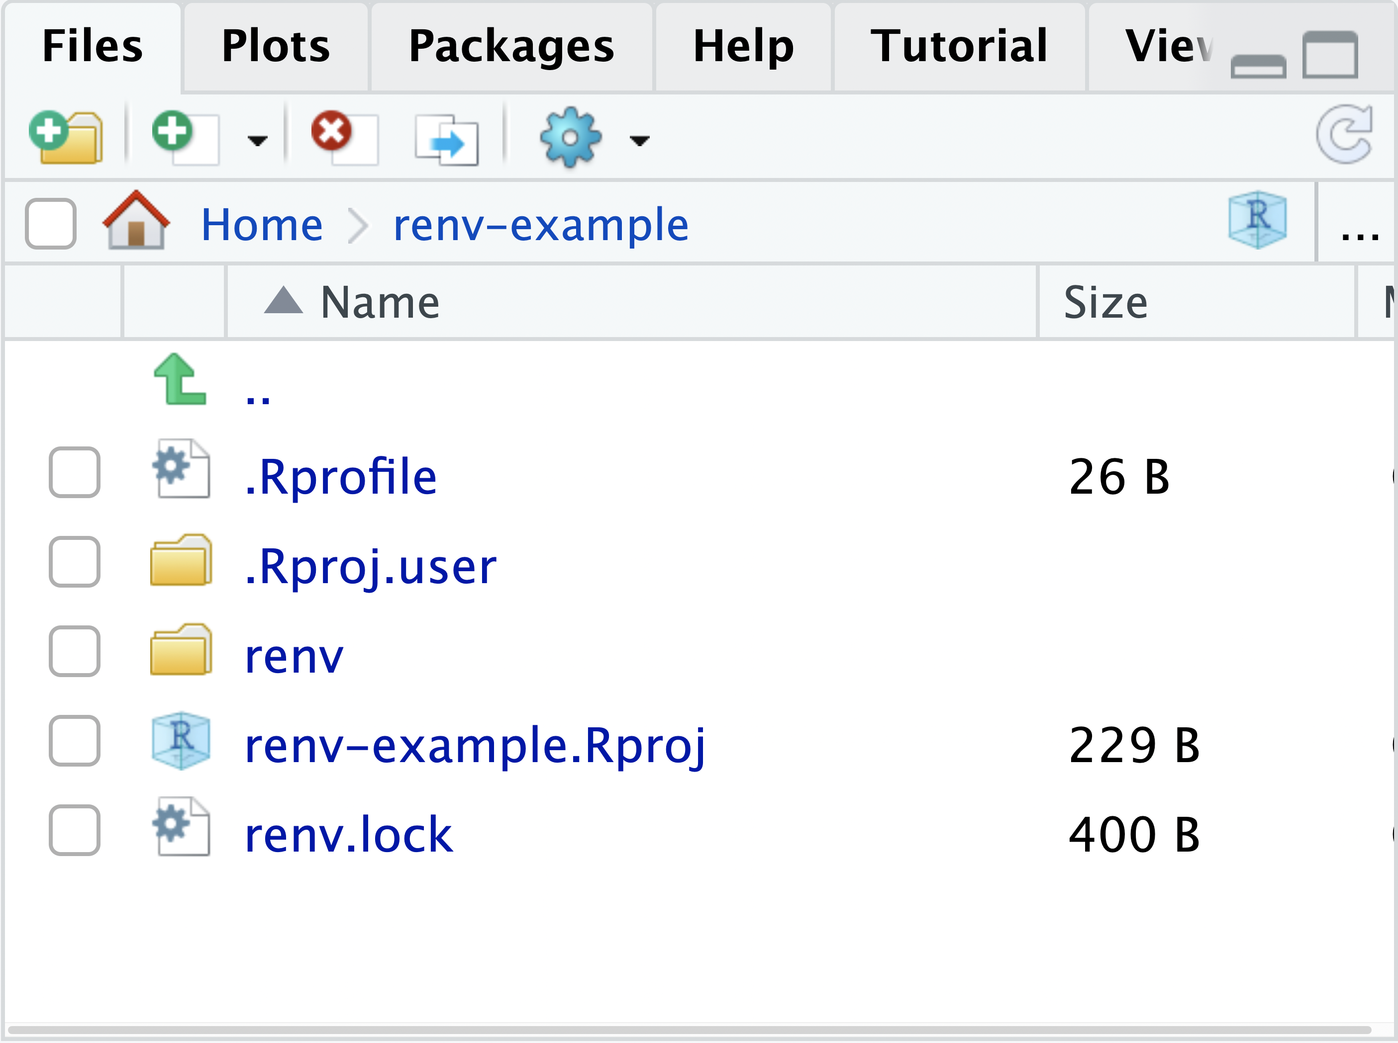
Setting a New Directory project
Personal project and {renv} package
It is also possible to initialize {renv} when creating a New Project;
{renv} associated files and folders will automatically appear, and the environment is set and updated:
https://docs.posit.co/ide/user/ide/guide/environments/r/renv.html, 02/08/2024

Slide 11
Setting a New Directory project
“manipulation_renv” project
Now, again, one more time, repeatedly, let’s create a personal project. But, this time, using {renv}!;
Name suggestion: “manipulation_renv” (so you won’t forget the purpose of the project);
Notice that “.Rprofile” and a personal/project library were already created (check with “.libPaths()”);
Install and load {tidyverse}, {admiral}, and {pharmaversesdtm} packages;
Update your renv.lock file: “renv::snapshot(type = “all”)”, to snapshot all packages in project library;
We are good to go!

Slide 12
Loading datasets
Dummies ADaMs and sdtm datasets

Slide 13
Loading datasets
{admiral} and {pharmaversesdtm} datasets
We already know that packages can also contain datasets, not only functions;
Let’s load dummies “adsl” from {admiral} and “vs” domain from {pharmaversesdtm};
They will be the object of use in this presentation and their data structures are “data frames” (other datasets may appear eventually).

Slide 14
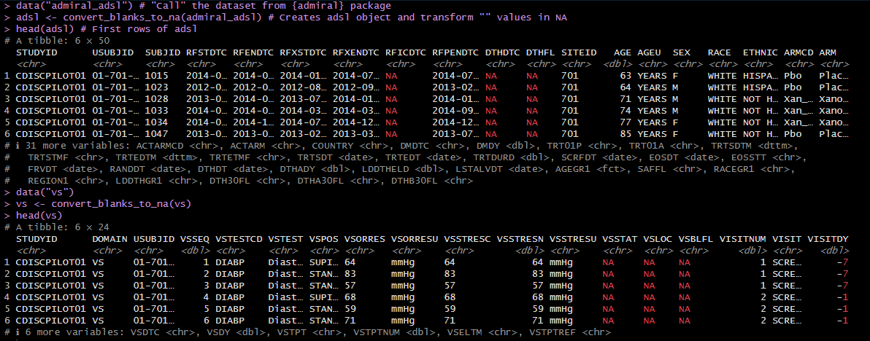
Loading datasets
{admiral} and {pharmaversesdtm} datasets
Loading “adsl” and “vs” datasets from packages

Slide 15
{tidyverse} family
Getting tidy data

Slide 16
{tidyverse} family
{tidyverse} and its core
The {tidyverse} is a collection of R packages designed for data science. All packages share an underlying design philosophy, grammar, and data structures;
The core {tidyverse} includes the packages that you’re likely to use in everyday data analyses: {ggplot2}, {dplyr}, {tidyr}, {readr}, {purrr}, {tibble}, {stringr}, {forcats}…;
The packages are not loaded automatically with “library(tidyverse)”, so you’ll need to load each one with its own call;
{tidyverse} packages load the pipe “%>%” operator (ctrl+shif+m), a revolution in the way the codes are written;
The major task of pipe operator is to forward a value, or the result of an expression, into the next function call/expression.

Slide 17
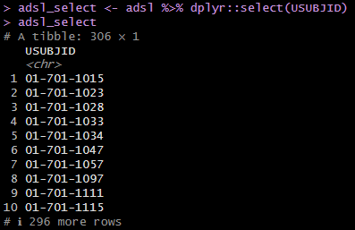
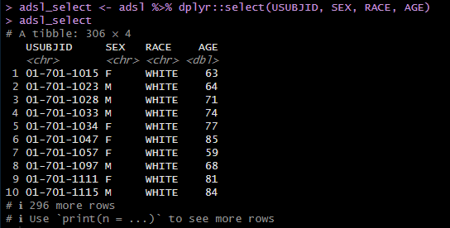
{tidyverse} family
dplyr::select()
“dplyr::select()” extracts columns in a data frame, using a concise mini-language that makes it easy to refer to variables based on their names:
Selecting variables by name

Slide 18
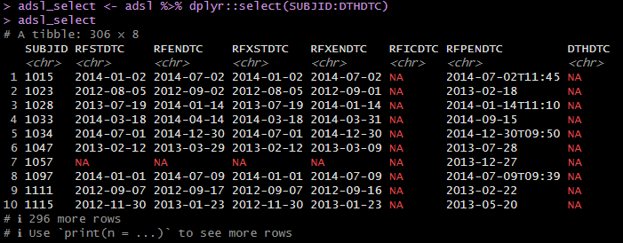
{tidyverse} family
Selecting a range of consecutive variables
One can use the “:” separator to select all columns from the left to the right of the separator:
Selecting variables in sequence

Slide 19
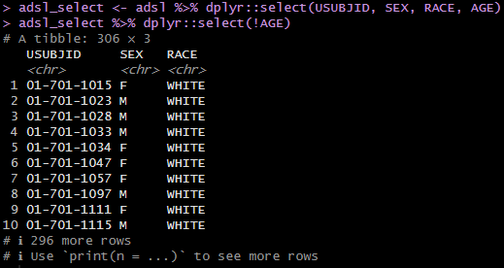
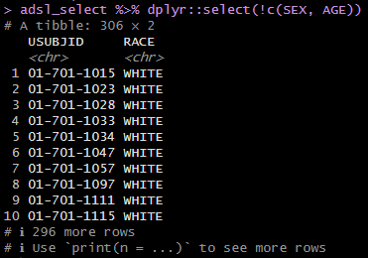
{tidyverse} family
dplyr::select()
One can use the “!” operator to take the complement of a set of variables:
Selecting the complement of variables

Slide 20
{tidyverse} family
dplyr::select()
Some “selection helper” functions can be used together with “dplyr::select()” to optimize the selection;
Select specific columns:
“everything()”: matches all variables;
“last_col()”: select the last variable, possibly with an offset;
“group_cols()”: select all grouping columns.
Select variables by matching patterns in their names
“starts_with()”: starts with a prefix;
“ends_with()”: ends with a suffix;
“contains()”: contains a literal string;
“matches()”: matches a regular expression;
“num_range()”: matches a numerical range like x01, x02, x03.

Slide 21
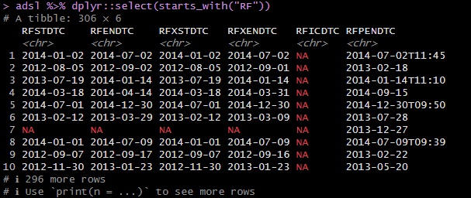
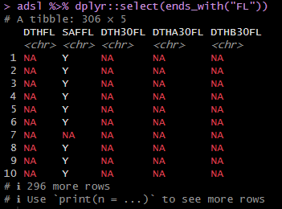
{tidyverse} family
dplyr::select()
starts_with() and end_with() examples

Slide 22
{tidyverse} family
dplyr::select()
Variables stored in a character vector:
“all_of()”: matches variable names in a character vector. All names must be present, otherwise an out-of-bounds error is thrown;
“any_of()”: same as “all_of()”, except that no error is thrown for names that don't exist.
Using a predicate function:
“where()”: applies a function to all variables and selects those for which the function returns TRUE.

Slide 23
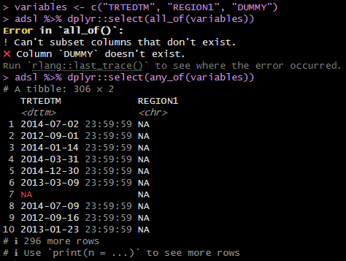
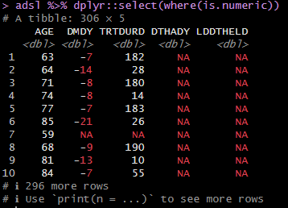
{tidyverse} family
dplyr::select()
all_of(), any_of and where() examples

Slide 24
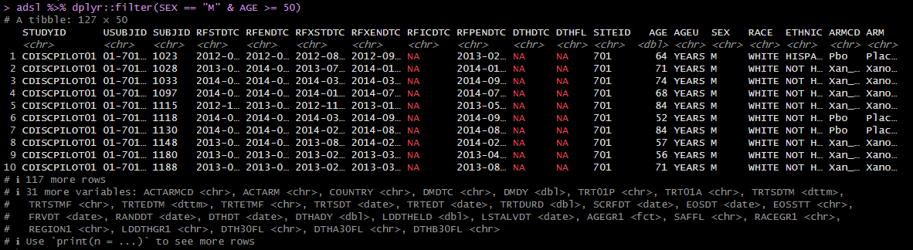
{tidyverse} family
dplyr::filter()
“dplyr::filter()” subsets a data frame, retaining all rows that satisfy your conditions. To be retained, the row must satisfy all conditions;
Filters can be applied using logical and relational operators:
Filtering adsl by SEX and AGE

Slide 25
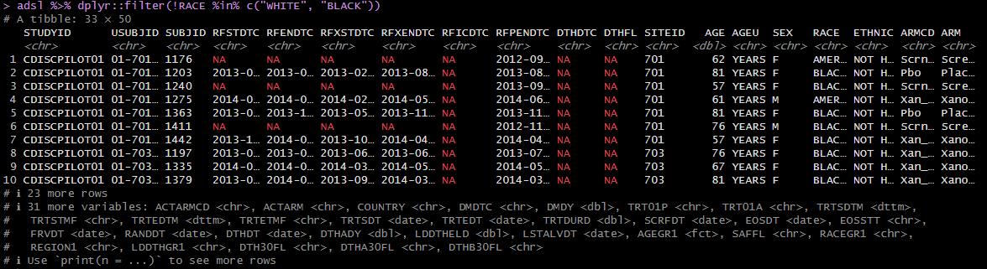
{tidyverse} family
dplyr::filter()
To filter a categorical variable according to multiple categories, the operator “%in%” is the best choice:
Filtering adsl by RACE

Slide 26
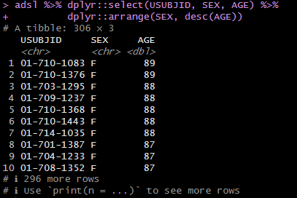
{tidyverse} family
dplyr::arrange()
“dplyr::arrange()” orders the rows of a data frame by the values of selected columns;
Can be used joint to “dplyr::desc()”, which transforms a vector into a format that will be sorted in descending order:
Arranging subset adsl data by SEX and descending AGE

Slide 27
{tidyverse} family
dplyr::mutate() and dplyr::case_when()
“dplyr::mutate()” creates new columns that are functions of existing variables. It can also modify (if the name is the same as an existing column) and delete columns (by setting their value to NULL);
“dplyr::case_when()” allows you to vectorize multiple “if_else()” statements. Each case is evaluated sequentially and the first match for each element determines the corresponding value in the output vector. If no cases match, the .default is used as a final "else" statement.

Slide 28
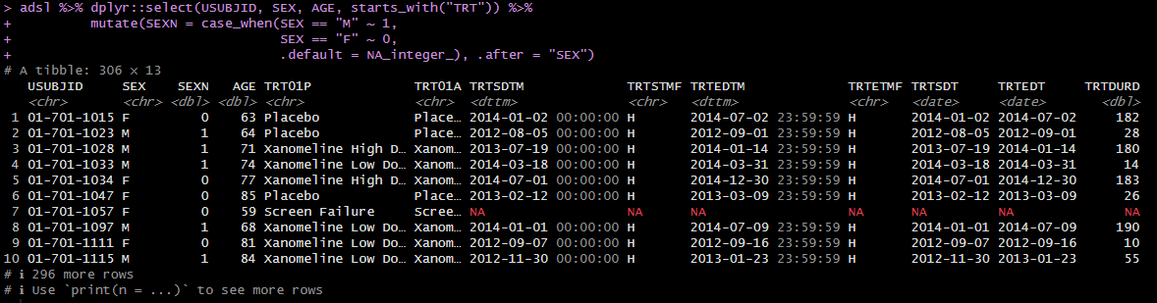
{tidyverse} family
dplyr::mutate() and dplyr::case_when()
Creating SEXN variable and placing it after SEX

Slide 29
{tidyverse} family
dplyr::group_by() and dplyr::summarise()
“dplyr::group_by()” takes an existing data frame and converts it into a grouped data frame where operations are performed "by group". “dplyr:: ungroup()” removes grouping;
“dplyr::summarise()” creates a new data frame. It returns one row for each combination of grouping variables; if there are no grouping variables, the output will have a single row summarising all observations in the input. It will contain one column for each grouping variable and one column for each of the summary statistics that you have specified.

Slide 30
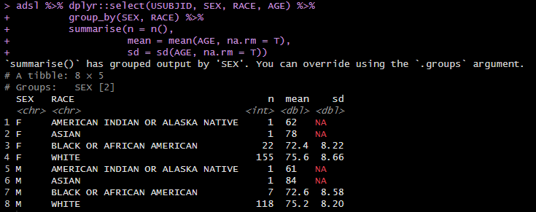
{tidyverse} family
dplyr::group_by() and dplyr::summarise()
Grouping adsl by SEX and RACE and summarizing AGE

Slide 31
{tidyverse} family
tidyr::pivot_wider() and tidyr::pivot_longer()
“tidyr::pivot_wider()” "widens" data, increasing the number of columns and decreasing the number of rows. Its main arguments are:
“names_from”: gets the name of the output(s) column(s);
“values_from”: which column(s) to get the cell values from.
“tidyr::pivot_longer()” "lengthens" data, increasing the number of rows and decreasing the number of columns. Its main arguments are:
“cols”: columns to pivot into longer format;
“names_to”: a character vector specifying the new column (or columns) to create from the information stored in the column names of data specified by cols;
“values_to”: a string specifying the name of the column to create from the data stored in cell values.
“vs” data, from {pharmaversesdtm} package, will be used in the following examples.

Slide 32
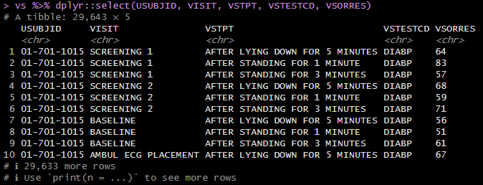
{tidyverse} family
´pharmaversesdtm::vs
Subset vs dataset

Slide 33
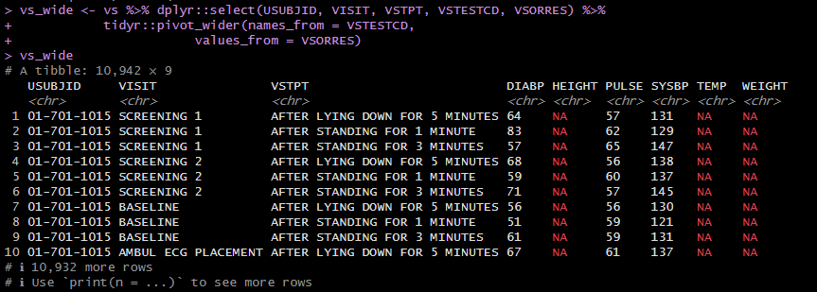
{tidyverse} family
tidyr::pivot_wider()
“Widening” VSTESTCD in vs dataset

Slide 34
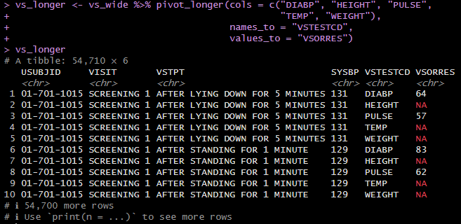
{tidyverse} family
tidyr::pivot_wider()
“Lengthening” vs_wide dataset

Slide 35
{tidyverse} family
Strings and base::cat()
In R, strings are created using either single quotes (') or double quotes ("). There’s no difference, but double quote is recommended, unless the string contains multiple “ " ”:
string1 <- "This is a string"
string2 <- 'If I want to include a "quote" inside a string, I use single quotes';
To include a literal single or double quote in a string use “\” to “escape” it:
double_quote <- "\"" # or '"'
single_quote <- '\'' # or "'"
To include a literal backslash, also escape it:
backslash <- "\\"
To output the strings escaping the objects, use “base::cat()” function to concatenate and print them.

Slide 36
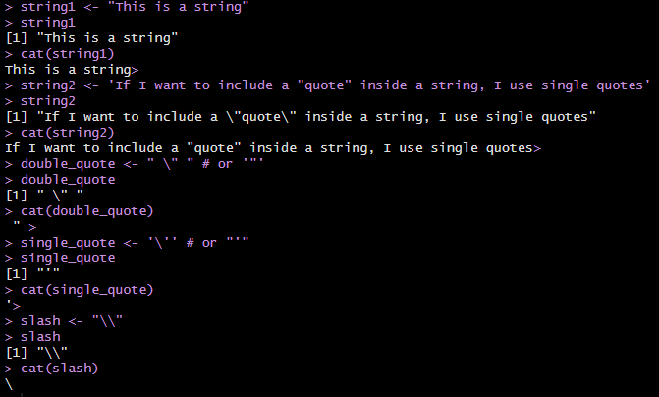
{tidyverse} family
base::cat()
Examples of escapes

Slide 37
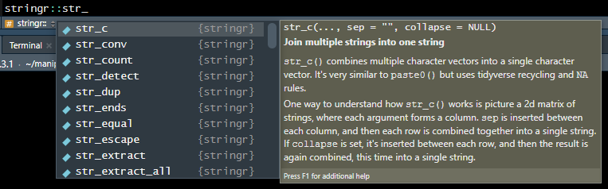
{tidyverse} family
stringr::str_
{stringr} package provides a cohesive set of functions designed to make working with strings as easy as possible;
Most of its function’s names start with “stringr::str_”
Examples of {stringr} functions that starts with “str_”

Slide 38
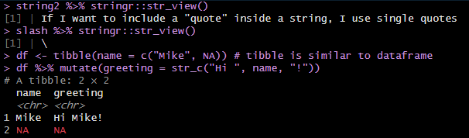
{tidyverse} family
stringr::str_view()
It is valuable to mention that {stringr} functions obey {tidyverse} rules for recycling and propagating missing values;
“stringr::str_view()” is used to print the underlying representation of a string and to see how a pattern matches. It plays the same role as “base::cat()”:
Viewing strings and exposing the NA propagation in {stringr}

Slide 39
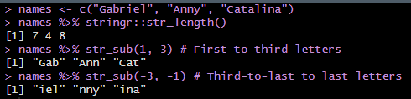
{tidyverse} family
stringr::str_length() and stringr::str_sub()
“stringr::str_length()” returns the number of codepoints/individual elements in a string;
“stringr::str_sub()” extracts or replaces the elements at a single position in each string. Its main arguments are:
“start, end”: a pair of integer vectors defining the range of characters to extract (inclusive):
Character processing using {stringr}

Slide 40
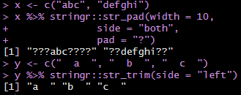
{tidyverse} family
stringr::str_pad() and stringr::str_trim()
“stringr::str_pad()” pads a string to a fixed length by adding extra characters on the left, right, or both sides. Its main arguments are:
“width”: minimum width of padded strings;
“side”: side on which padding character is added (left, right, or both);
“pad”: single padding character (default is a space).
“stringr::str_trim()” removes leading and trailing whitespace. Its main arguments are:
“side”: side on which to remove whitespace (left, right, or both):
Dealing with spaces using {stringr}

Slide 41
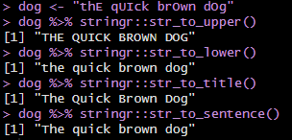
{tidyverse} family
stringr::str_to_: c(upper(), lower(), title(), sentence())
“stringr::str_to_xxx()” convert string to upper case, lower case, title case, or sentence case:
Case changing using {stringr}

Slide 42
{tidyverse} family
stringr::str_: c(detect(), subset(), count(), locate(), locate_all())
“stringr::str_detect()” detects the presence or absence of a pattern and returns a logical vector (TRUE or FALSE). Its main arguments are:
“pattern”: the pattern to look for;
“negate”: if TRUE, inverts the resulting boolean vector.
“stringr::str_subset()” returns all string elements with at least one match to the pattern. Its main arguments are “pattern” and “negate”;
“stringr::str_count()” counts the number of times a pattern is found within each element of a string. Its main argument is “pattern”;
“stringr::str_locate()” locates the first position of a pattern and returns a numeric matrix with start and end positions. Its main argument is “pattern”.
“stringr::str_locate_all()” locates each position of a pattern.

Slide 43
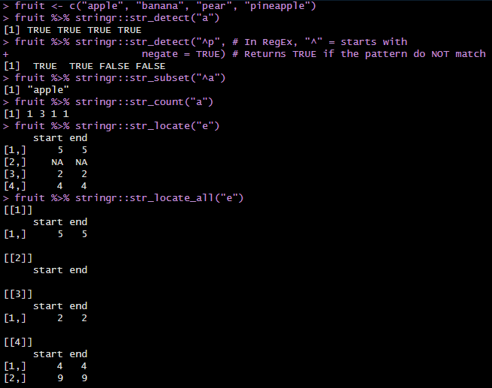
{tidyverse} family
stringr::str_: c(detect(), subset(), count(), locate(), locate_all())
Pattern matching using {stringr}

Slide 44
{tidyverse} family
stringr::str_: c(extract(), match(), replace(), remove())
“stringr::str_extract()” extracts text corresponding to the first match, returning a character vector. Its main argument is “pattern”. “stringr::str_extract_all()” extracts all matches from each string.
“stringr::str_match()” captures groups formed by a pattern for the first match. Its main argument is “pattern”, which must be a RegEx;
“stringr::str_replace()” replaces the first match. Its main arguments are “pattern” and:
“replacement”: the replacement value, usually a single string;
“stringr::str_replace_all()” replaces all matches;
“stringr::str_remove()” removes matches, i.e. replaces them with "".
“stringr::str_remove_all()” removes all matches.

Slide 45
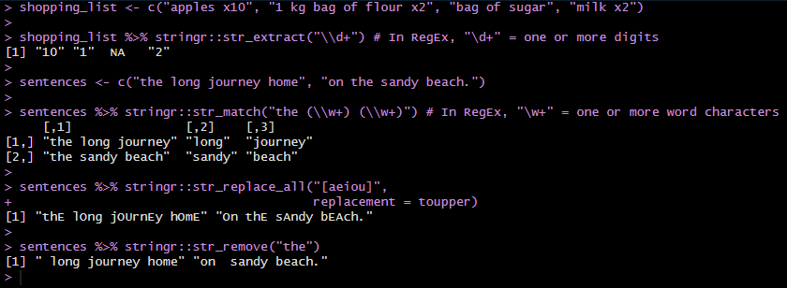
{tidyverse} family
stringr::str_: c(extract(), match(), replace(), remove())
Pattern matching using {stringr}

Slide 46
{tidyverse} family
stringr::str_: c(split_fixed(), split_i(), dup(), flatten())
“stringr::str_split_fixed()” splits each string in a character vector into a fixed number of pieces, returning a character matrix. Its main arguments are “pattern” and:
“n”: maximum number of pieces to return. Default (Inf) uses all possible split positions;
“stringr::str_split_i()” splits each string in a character vector into pieces and extracts the ith value, returning a character vector. Its main arguments are “pattern” and:
“i”: element to return. Use a negative value to count from the right-hand side;
“stringr:: str_dup()” duplicates the characters within a string. Its main argument is:
“times”: number of times to duplicate each string;
“stringr::flatten()” reduces a character vector to a single string. Its main arguments are:
“collapse”: string to insert between each piece. Defaults to "";
“last”: optional string to use in place of the final separator.

Slide 47
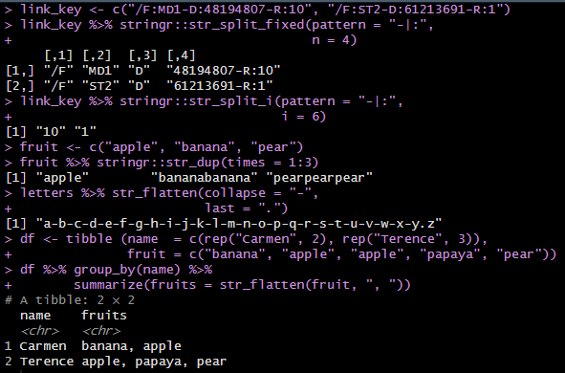
{tidyverse} family
stringr::str_: c(split_fixed(), split_i(), dup(), flatten())
Pattern matching using {stringr}

Slide 48
Functions
Manipulation on demand

Slide 49
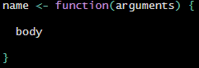
Functions
Introduction
Functions allow automation of common tasks in a more powerful and general way than copy-and-pasting, similarly to SAS macros;
Consider writing a function if the code is repeated more than twice;
To write a function first analyze the repeated code to figure out what parts are constant and what parts vary;
To turn that code into a function you’ll need three are:
A name: name of the function;
The arguments: inputs that vary across calls;
The body: the code that’s repeated across all the calls.
Function structure

Slide 50
Functions
Introduction
Functions can be passed as arguments to other functions;
Functions can be nested, i.e. a function can be defined inside of another function;
The return value of a function is the last expression in the function body to be evaluated;
Function arguments can be missing or might have default values;
Positional arguments can be mixed with named arguments;
Function name is first searched in the global environment, then in the namespaces of each of the packages.

Slide 51
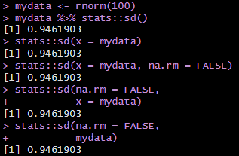
Functions
Different calls, same result
Standard deviation of data called in different ways

Slide 52
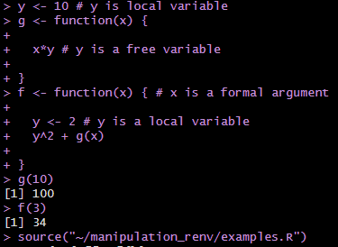
Functions
Lexical scope
The scoping rules determine how values are assigned to free variables;
In R the values of free variables are searched for in the environment in which the function was defined, then in the parent environment until the top-level parent environment is reached;
Variables in a function

Slide 53
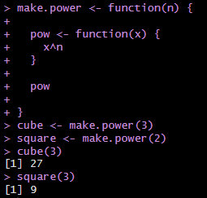
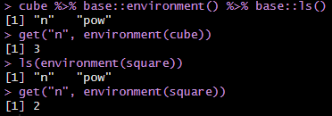
Functions
Lexical scope
A function can return a function as its value;
To get the function environment, you can use the “base::environment()” function:
Function returning function and its environment

Slide 54
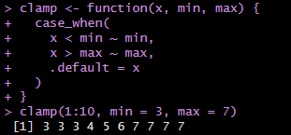
Functions
Functions and {dplyr} package – vector functions
Vector functions are useful for pulling out code that’s repeated within a {dplyr} verb;
The first type is the “mutate” functions, which return an output of the same length as the input, so work well inside of “dplyr::mutate()” and “dplyr::filter()”:
Vector functions

Slide 55
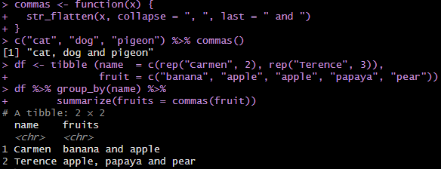
Functions
Functions and {dplyr} package – vector functions
The second type is the “summary” functions, which return a single value for use in “dplyr::summarise()”:
Vector functions

Slide 56
Functions
Functions and {dplyr} package – data frame functions
Data frame functions are useful for pulling out repeated {dplyr} verbs;
They should be considered if multiple verbs have to be copied and pasted multiple times;
Data frame functions work like {dplyr} verbs: they take a data frame as the first argument, some extra arguments that say what to do with it, and return a data frame or a vector;
But there is a problem, called indirection!

Slide 57
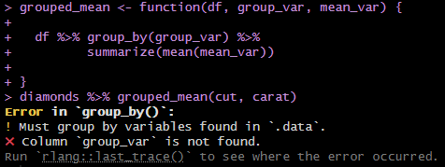
Functions
Data frame functions - indirection issue
The functions will always search for the name of the argument in data frame, instead of the name of the passed variable:
Indirection issue in data frame functions

Slide 58
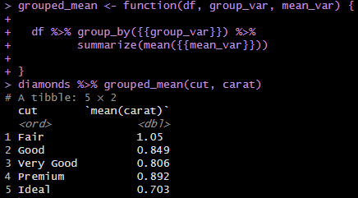
Functions
Data frame functions - indirection issue
Tidy evaluation includes a solution to this problem: embracing ;)
Embracing a variable tells {dplyr} to use the value stored inside the argument by using “{{}}”:
Indirection issue resolved in data frame functions

Slide 59
Vectorization
Speeding up the process

Slide 60
Vectorization
dplyr::across()
Vectorization is the process of converting an algorithm from operating on a single value at a time to operating on a set of values (vector) at one time;
One option to vectorize functions is to use “dplyr::across()” function, which apply the same transformation to multiple columns, allowing you to use “dplyr::select()” semantics inside in "data-masking" functions like “dplyr::summarise()” and “dplyr::mutate()”

Slide 61
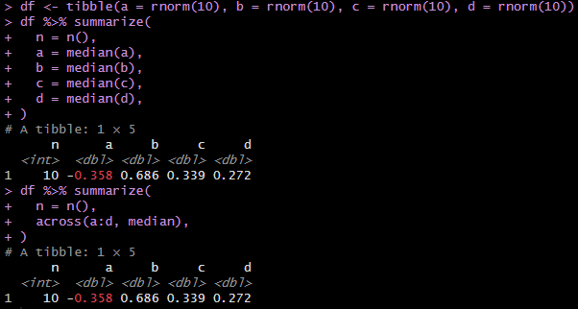
Vectorization
dplyr::across()
Vectorization using dplyr::across()

Slide 62
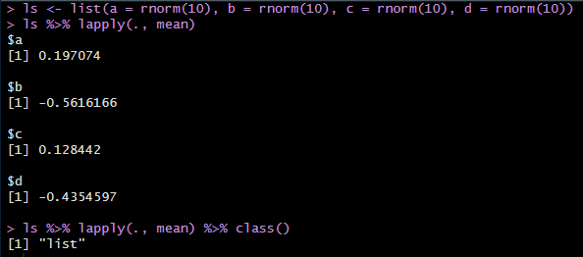
Vectorization
base::lapply()
“base::lapply()” returns a list of the same length as the input, each element of which is the result of applying a function to the corresponding element of the input. Its main arguments are:
“X”: a list;
“FUN”: the function to be applied to each element of X.
Base::lapply() vectorizing a list

Slide 63
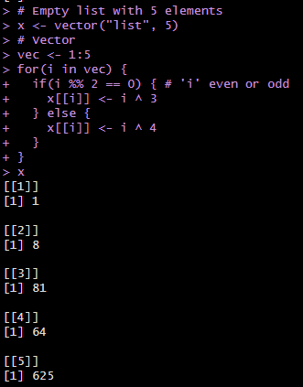
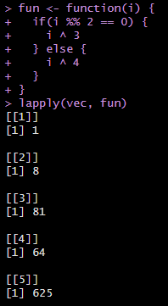
Vectorization
base::lapply()
Base::lapply() vectorizing a list

Slide 64
Useful links and Q&A
Good references ;)

Slide 65
Useful links and Q&A
Useful links
R 4 Data Science;
SWIRL;
Training By Packt;
Vicky Tanzil’s presentations about RegEx (minute 32);
Quick check of RegEx;
RStudio add-in for RegEx;
{stringr} cheatsheet.

Slide 66

Useful links and Q&A
Questions

